Slide 1
Timeline of early agricultural settlements
(INDIA)

Slide 2
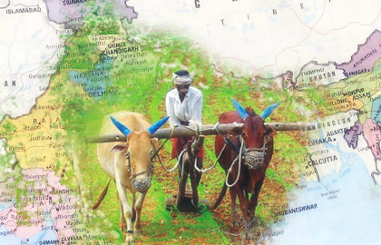
How it all started?
According to written history Indian agriculture began by 9000 BCE on north-west India as a result of early cultivation of plants, and domestication of crops and animals.
Settled life soon followed with implements and techniques being developed for agriculture Double monsoons led to two harvests being reaped in one year. Indian products soon reached the world via existing trading networks and foreign crops were introduced to India, Plants and animals were considered essential to their survival by the Indians and came to be worshiped

Slide 3
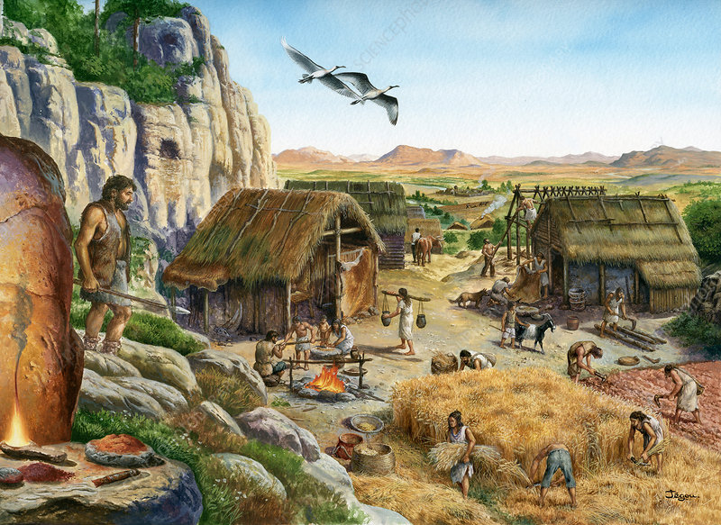
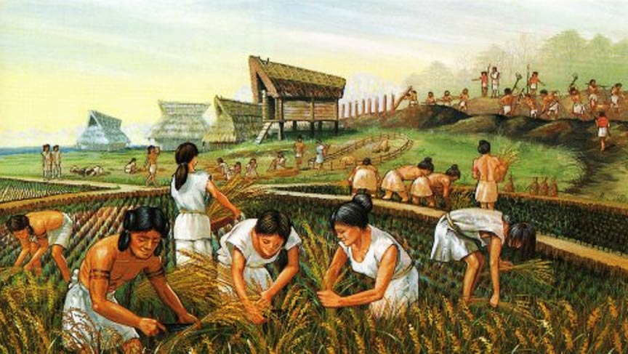
Neolithic (8000-4000 BCE)
In the period of the neolithic revolution, roughly 8000-4000 BCE, agro-pastoralism in India included threshing, planting crops in rows-either of two or of six-and storing grain in granaries. Barley and wheat cultivation-along with the rearing of cattle, sheep and goat-was visible in Mehrgarh by 8000-6000 BCE.

Slide 4
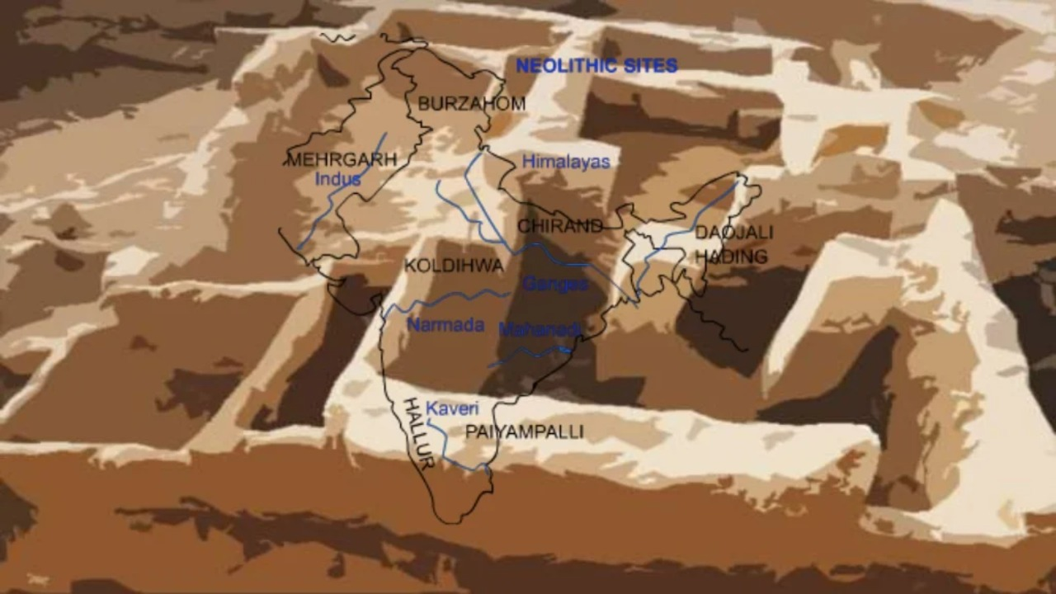

Slide 5
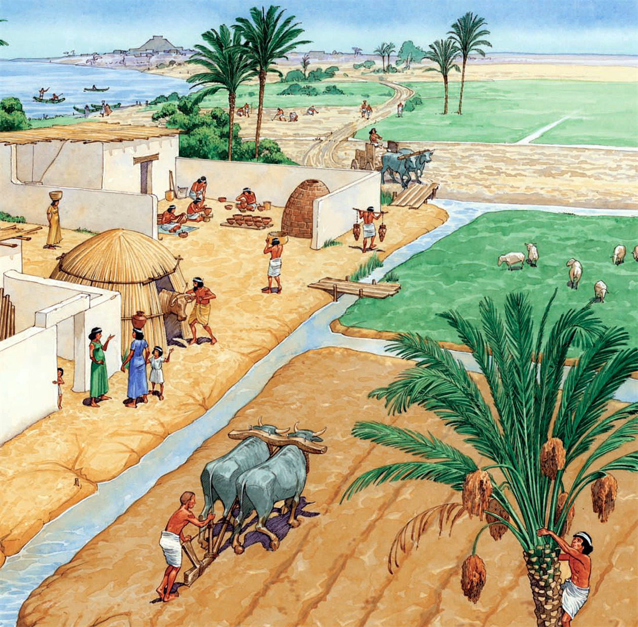
The Indus Valley Civilization (3300-1300 BCE)
Irrigation was developed in the Indus valley civilization by around 4500 BCE. The size an prosperity of the indus valley civilization grew as a result of this innovation, which eventually led to more planned settlements making use of drainage and sewers.
Sophisticated irrigation and water storage systems were developed by Indus valley civilization, including artificial reservoirs Girnar dated to 3000 BCE, and an early canal irrigation system from circa 2600 BCE.

Slide 6
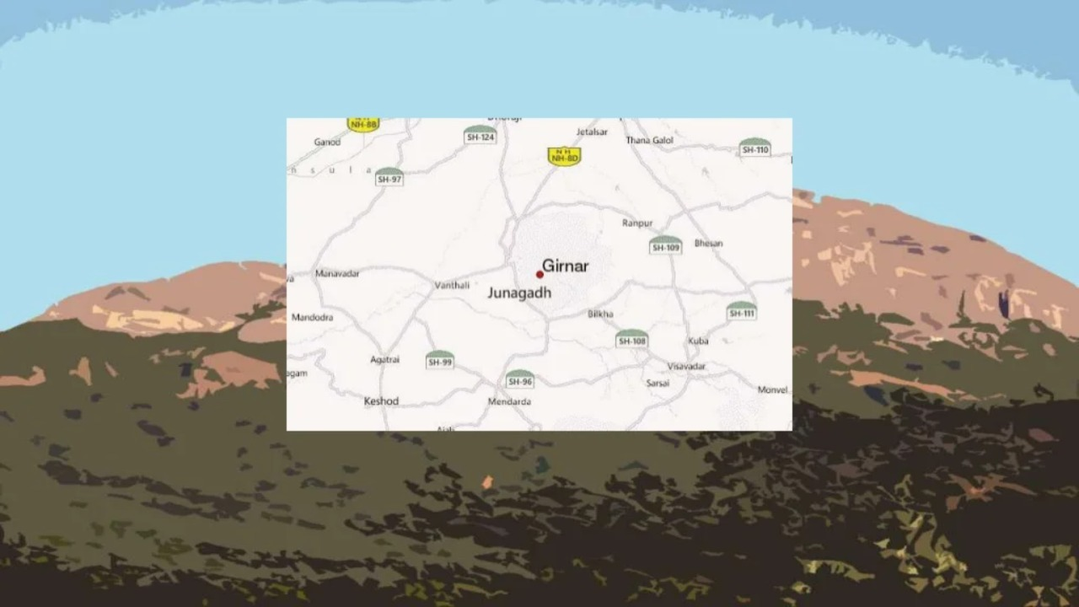

Slide 7
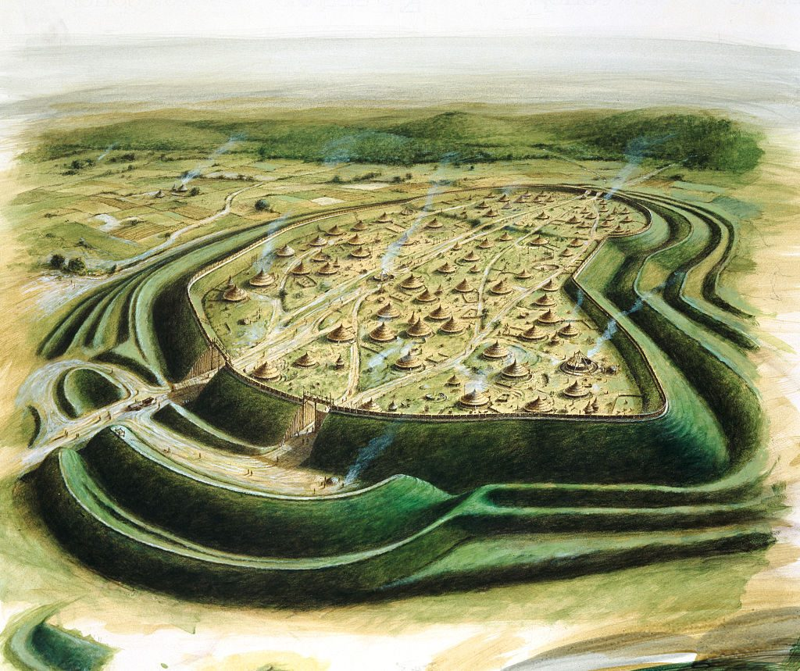
Iron age (1500-200 BCE)
In the Vedic texts (c. 3000 -2500 BC) there are repeated references to agricultural technology and practices, including iron implements, the cultivation of cereals, vegetables, and fruits; the use of meat and milk and animal husbandry.
Farmers ploughed the soil...broadcast seeds, and used a certain sequence of cropping and fallowing. Cow dung was mixed in soil for fertility and made meteorological observations for agricultural use . Other Mauryan facilitation included construction and maintenance of dams, and provision of horse-drawn chariots-quicker than traditional bullock carts

Slide 8
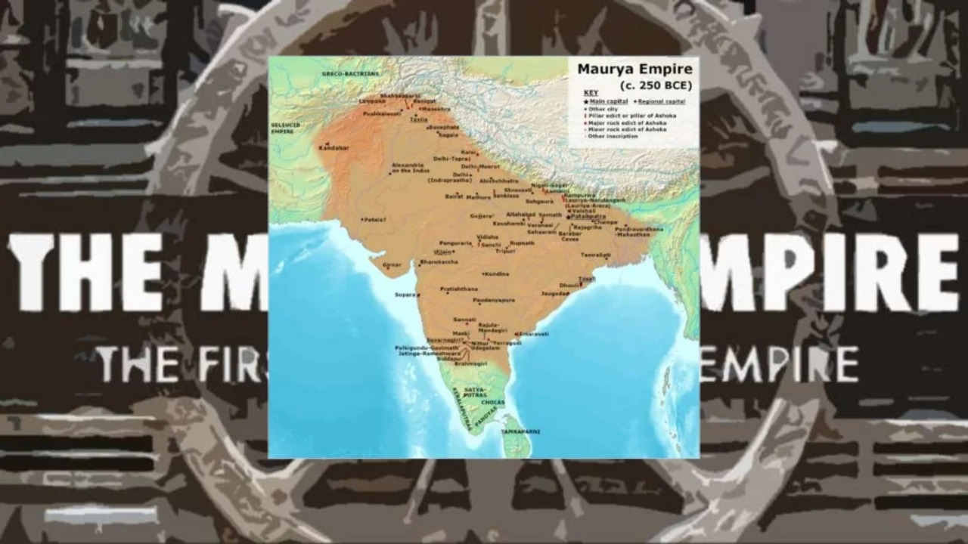
Mauryan Empire (321-297 BC)

Slide 9
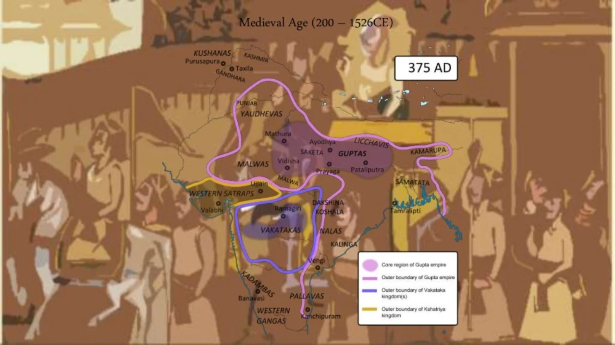
Medievial Age (200-1526 CE)

Slide 10
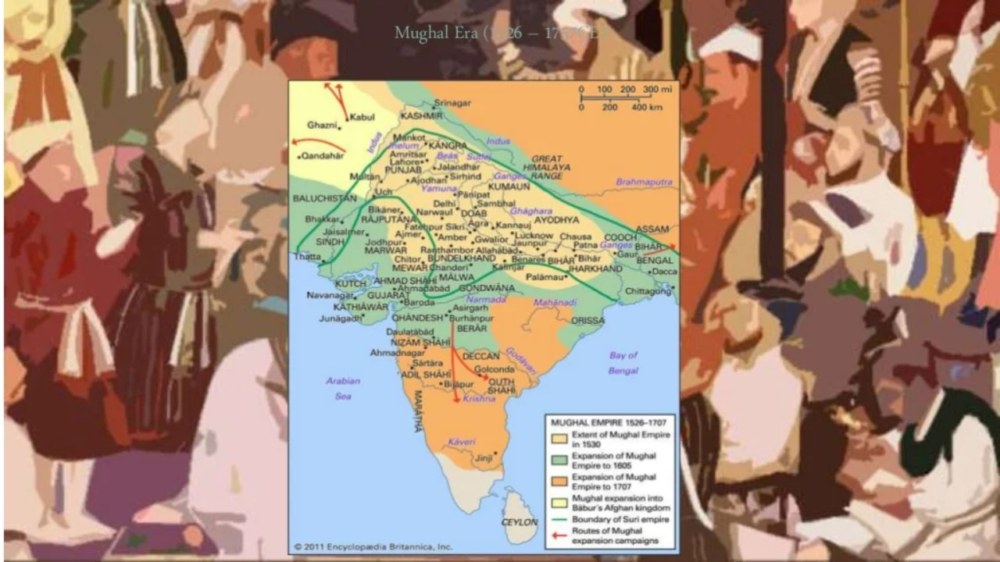
Mughal Era (1526-1707 CE)

Slide 11
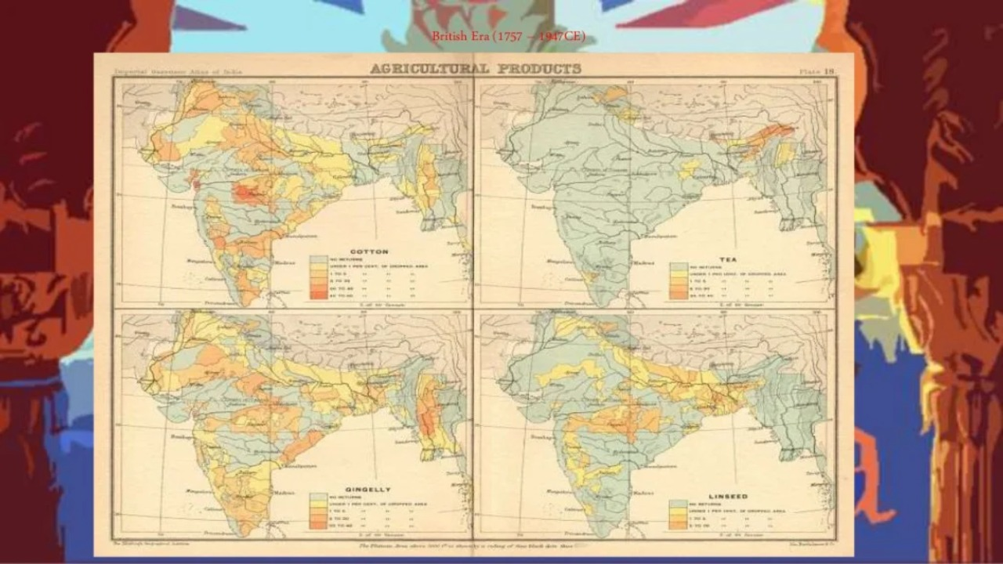
British Era (1757-1947 CE)

Slide 12
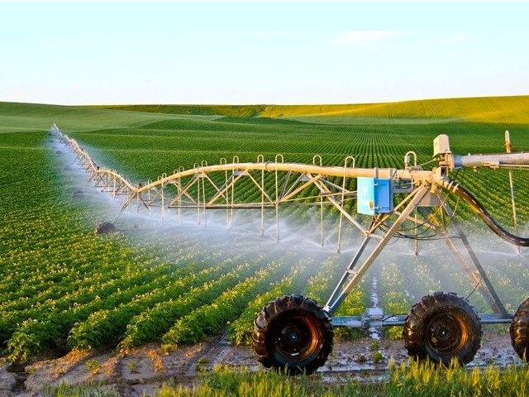
After Independence
Land use pattern of India was reviewed. The basic factor in agriculture is land. A knowledge about land use pattern is vital to understand whether the utilisation of land in India is at its full potential or far from its full potential.
Irrigation facilities are very much improvised according the soil fertility, topography of area etc.
Awareness among farmers are created by government through various policies and campaigns.

Slide 13
Thank You
Made by:

